Slide 1

FED Academy

Slide 2
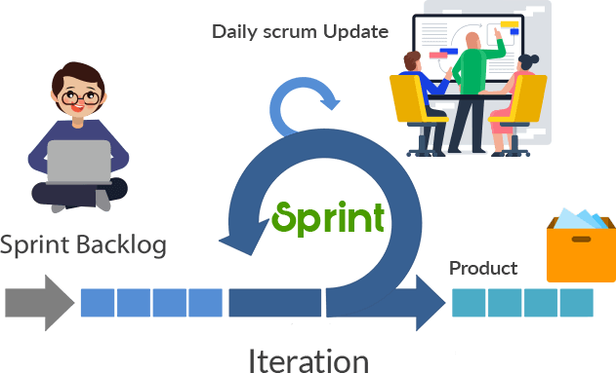




Week #1

Slide 3



Week #2

Slide 4



Week #3

Slide 5

Travel Blog

Slide 6
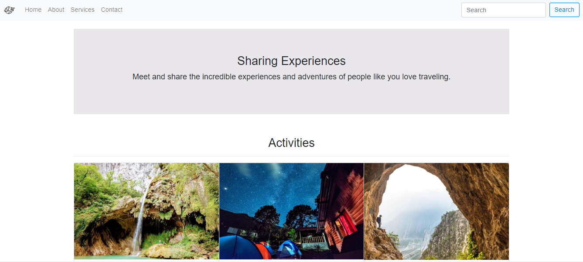
Travel Blog

Slide 7
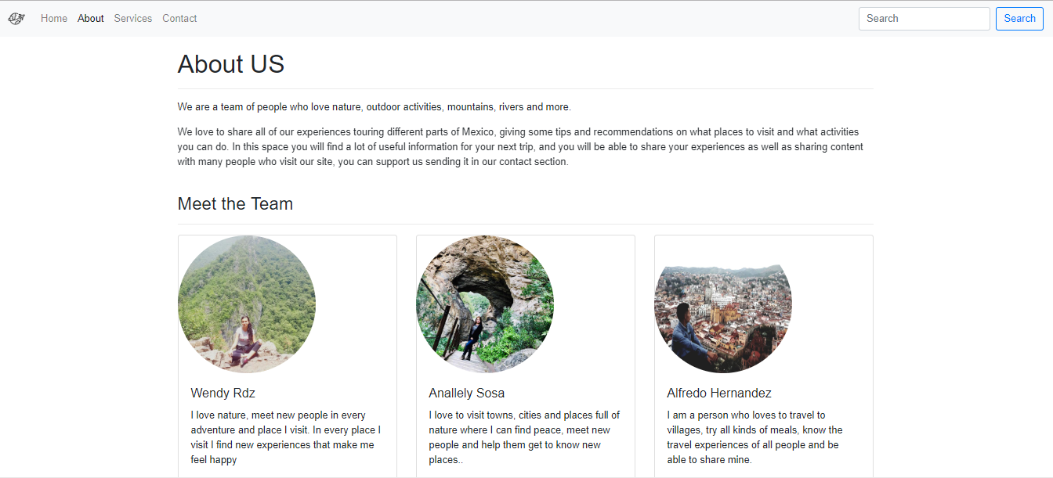
Travel Blog

Slide 8
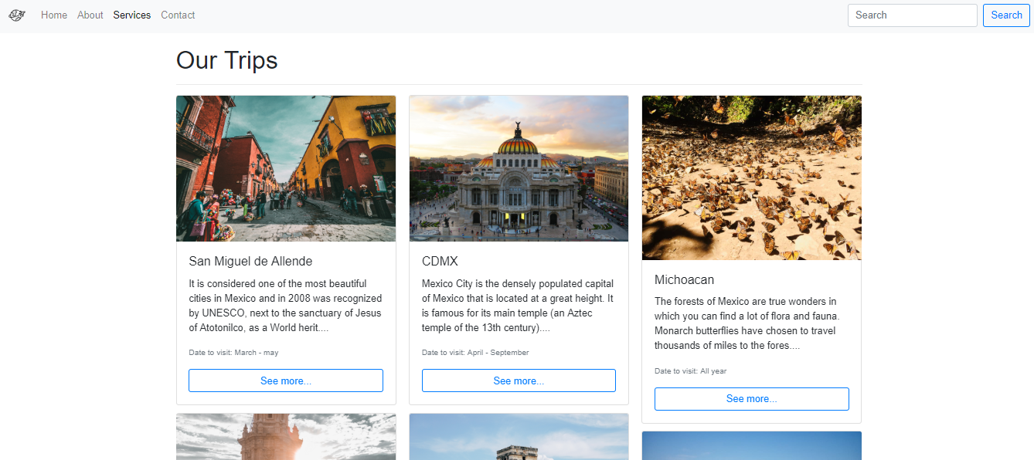
Travel Blog

Slide 9
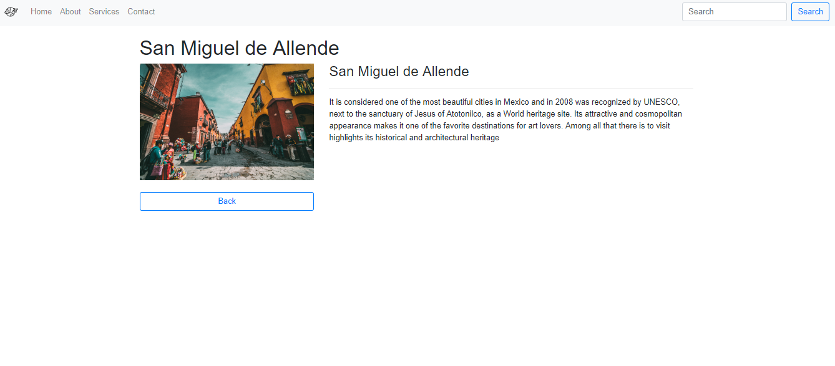
Travel Blog

Slide 10
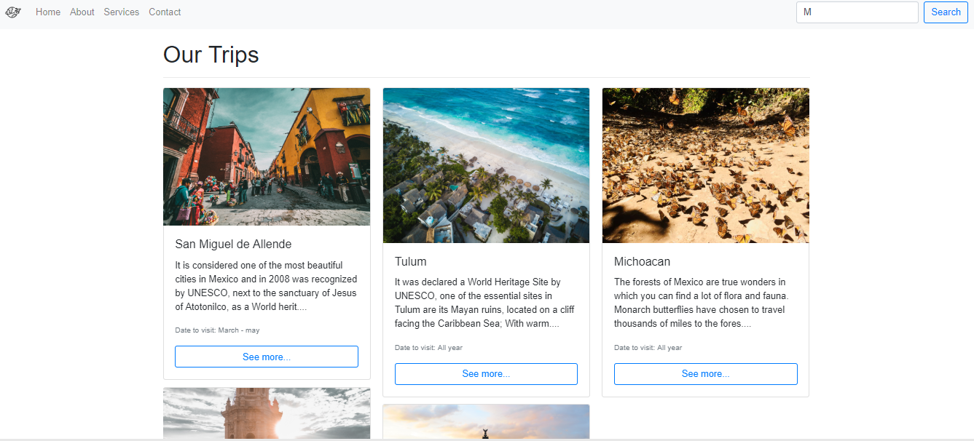
Travel Blog

Slide 11
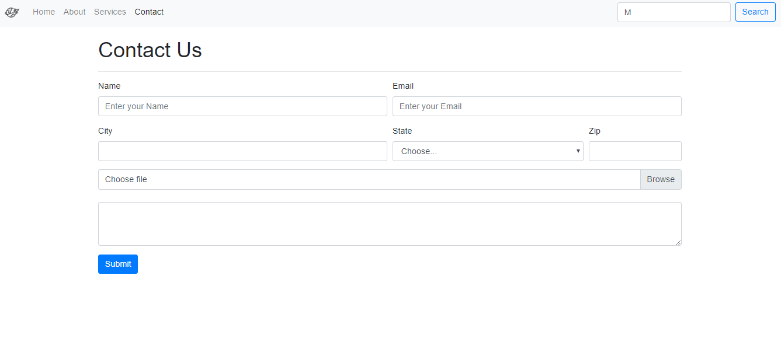
Travel Blog

